Slide 1
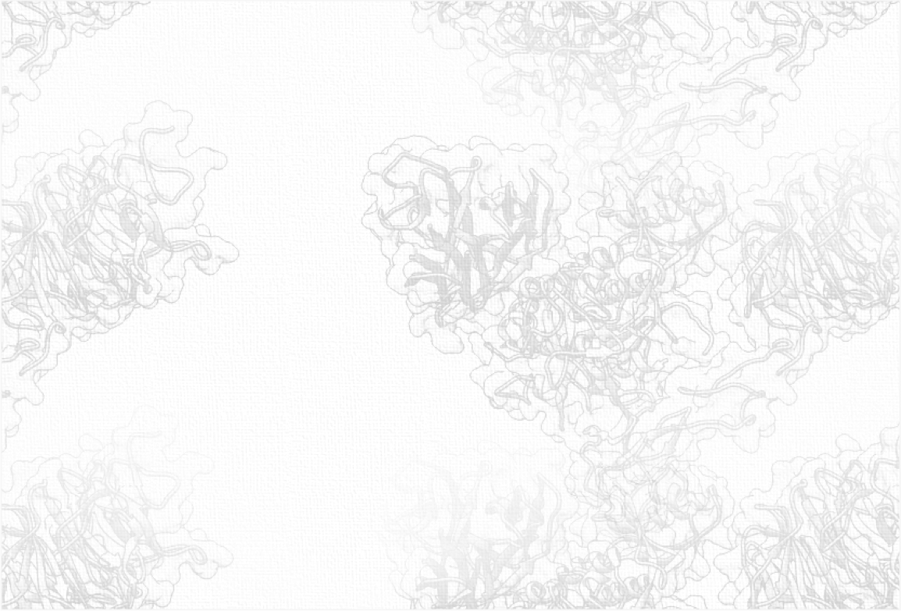
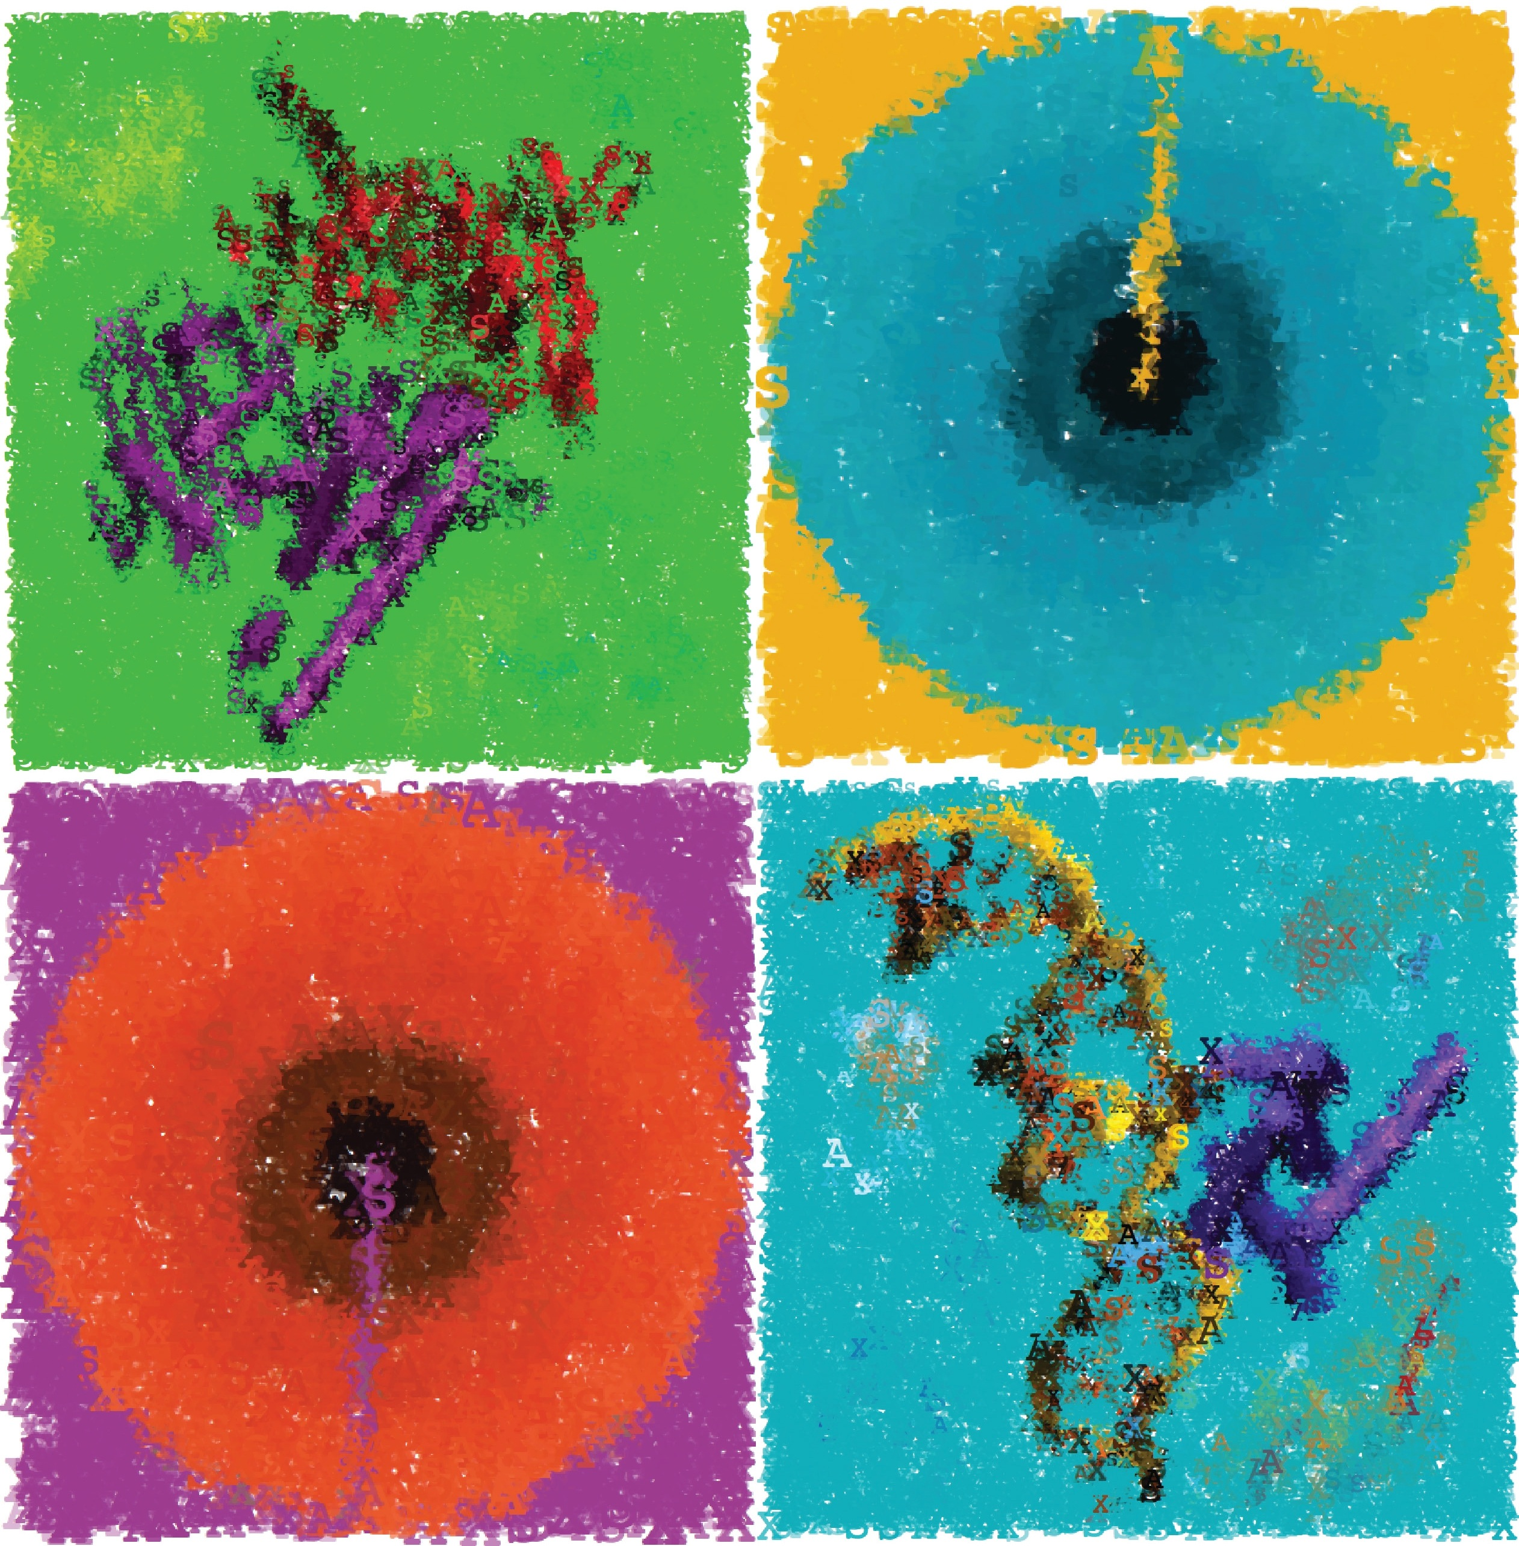
3D Data Processing in Structural Biology Lecture 7 Molecular Surfaces & Docking
May 19, 2020

Slide 2
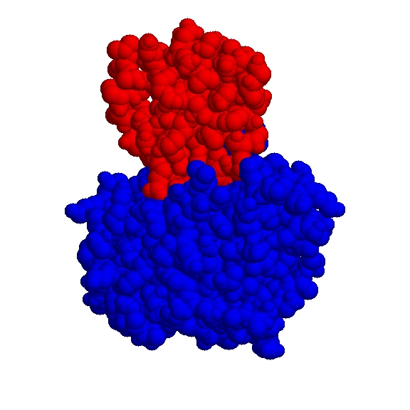
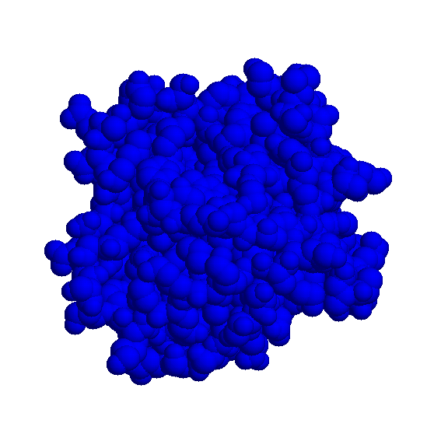
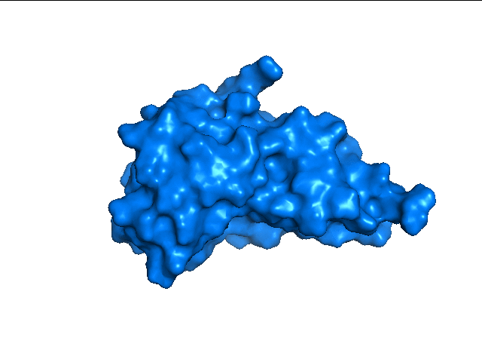
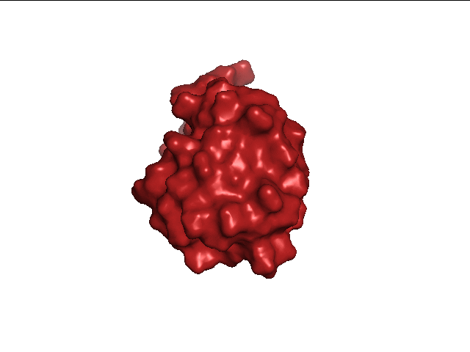
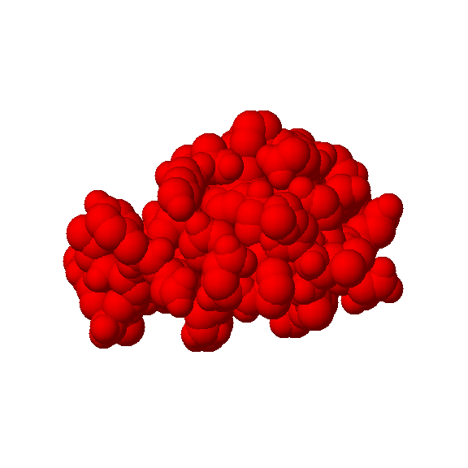
The Docking Problem
Given 2 input molecules in their native conformation, the goal is to find their correct association as it appears in nature.
T
?
+
Complex
Receptor
=
Ligand

Slide 3
The Docking Problem
Input: A pair of molecules (“receptor” and “ligand” represented by their 3D structures
Tasks:
Decide whether the molecules will form a complex (interact/bind)
Determine the binding affinity
Predict the 3D structure of the complex
Deduce function

Slide 4
Significance/Applications/Motivation
Computer aided drug design – detection of lead compounds. Prediction of side-effects
Elucidation of biochemical pathways - governed by biomolecular recognition and interactions
Huge no. of potential complexes – requires computational screening

Slide 5
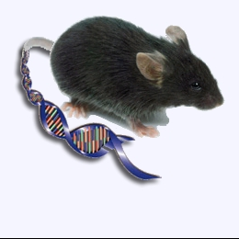
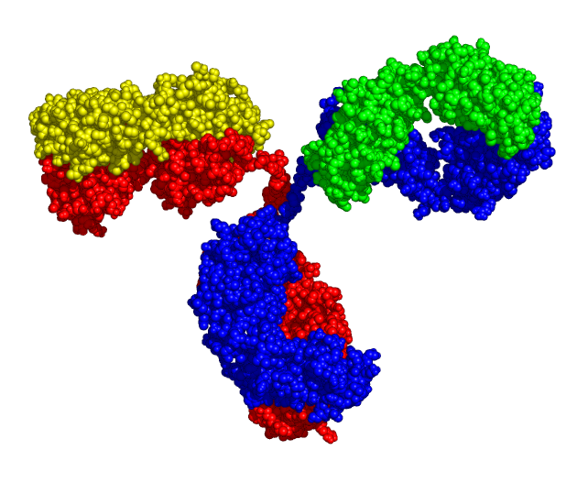
Application to Antigen-Antibody Complexes
Antibodies constitute a rapidly growing class of human therapeutics
A fast and reliable method for epitope detection would be extremely helpful in many stages:
selection of antibodies to humanize
developing hypotheses for mechanism of action
strengthening intellectual property claims around efficacious molecules
Notes:
Antibody-antigen docking is especially interesting sub-problem, since antibodies are a rapidly growing class of drugs. Epitope detection can help in many stages of drug design, such as antibody selection for optimization and humanization, understanding mechanism of action and more.

Slide 6
Necessary condition for Docking
shape complementarity
no steric clashes
T
=
Complex
+
Receptor
Ligand
Notes:
We can describe the problem as assembling of a jigsaw puzzle. Given two molecules, referred to as the receptor and the ligand, we attempt to predict the shape of their complex as it appears in nature.
From the mathematical view point we are looking for a transformation (rotation and translation) in 3D space that aligns best the surfaces of the molecules without causing collisions.

Slide 7
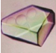
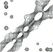

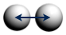
Integrative Structure Modeling
input structures:
Information
X-ray
crystallography
NMR spectroscopy
physical principles
shape complementarity
Representation & Scorin g
molecular surfaces
steric clash score
shape complementarity score
Sampling
Analysis

Slide 8
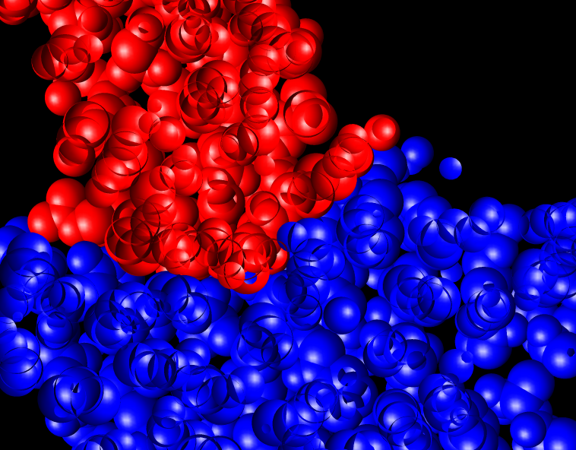
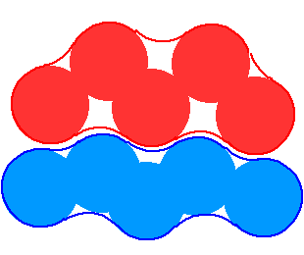
Geometric Docking Algorithms
Based on the assumption of shape complementarity between the participating molecules
Molecular surface complementarity - protein-protein, protein-ligand, (protein - drug)
Remark : usually “protein” here can be replaced by “DNA” or “RNA” as well

Slide 9
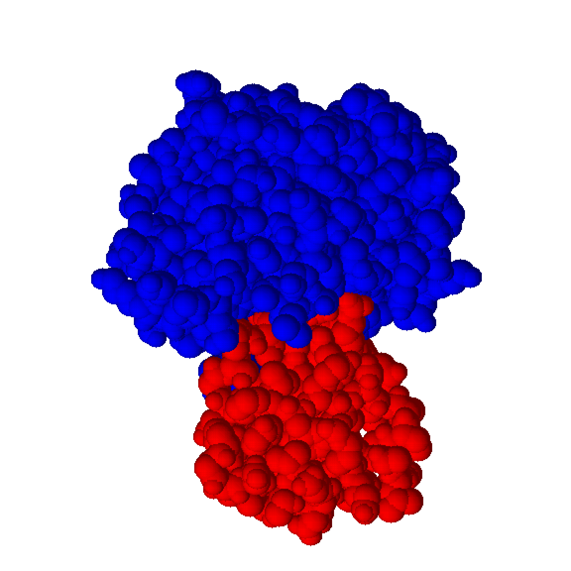
Bound Docking
In the bound docking we are given a complex of 2 molecules
After artificial separation the goal is to reconstruct the native complex
No conformational changes are involved
Used as a first test of the validity of the algorithm
Docking Algorithm
Notes:
There are two main classes of docking problem: test docking, called bound and real docking, called unbound.
…

Slide 10
Unbound Docking
In the unbound docking we are given 2 molecules in their native conformation
The goal is to find the correct association
Problems: conformational changes (side-chain and backbone movements), experimental errors in the structures
Notes:
Unbound docking is a “real life” problem. We are given two molecules that were separately crystallized.
We look for their conformation as it appears in the natural complex. This is especially difficult due to
many conformational changes such as side-chain and backbone flexibility.

Slide 11
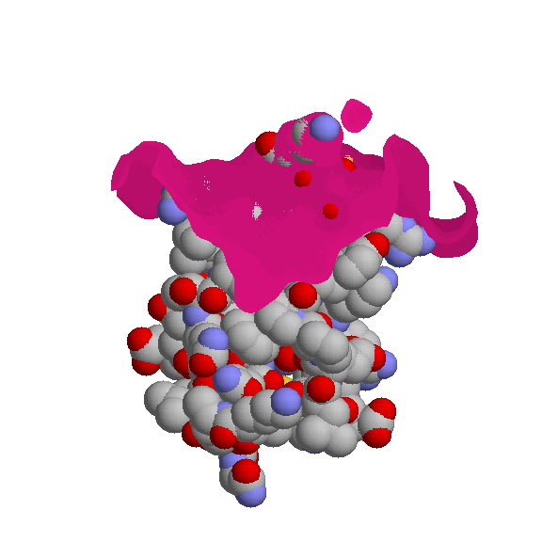
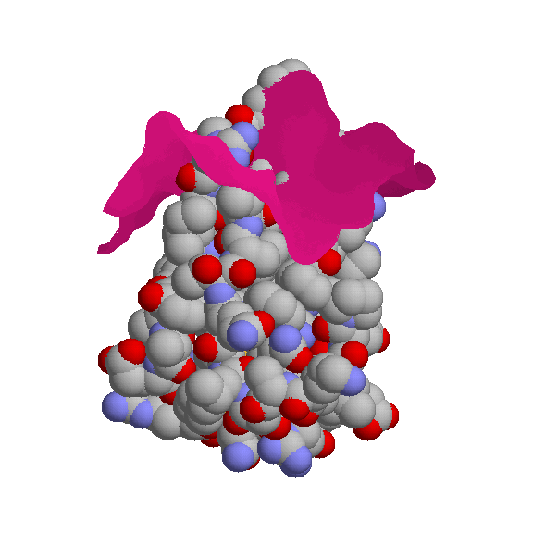
Bound vs. Unbound
Receptor surface
10 highly penetrating residues
Ligand
Unbound ligand and receptor
superimposed on the complex
Kallikrein A/trypsin inhibitor complex (PDB codes 2KAI,6PTI)
Notes:
Here we can see an example of side-chain flexibility. We show the ligand and the receptor surface.
As one can see in the bound complex there is almost perfect shape complementarity.
When we superimpose unbound molecules to the complex we can see that shape
complementarity is greatly affected, resulting in 10 highly penetrating residues.

Slide 12
Issues to be examined when evaluating docking methods
Rigid docking vs. flexible docking:
If the method allows flexibility:
Is flexibility allowed for ligand only, receptor only or both?
No. of flexible bonds allowed and the cost of adding additional flexibility
Does the method require prior knowledge of the active site?
Performance in “unbound” docking experiments
Speed - ability to explore large libraries

Slide 13
Integrative Structure Modeling
input structures:
Information
X-ray
crystallography
NMR spectroscopy
physical principles
shape complementarity
Representation & Scoring
molecular surfaces
steric clash score
shape complementarity score
Sampling
Analysis

Slide 14
Molecular Surface Representation
Applications to docking

Slide 15
Motivation
Studies of protein folding (Lee and Richards).
Prediction of biomolecular recognition.
Detection of drug binding ‘cavities’.
Molecular Graphics.

Slide 16
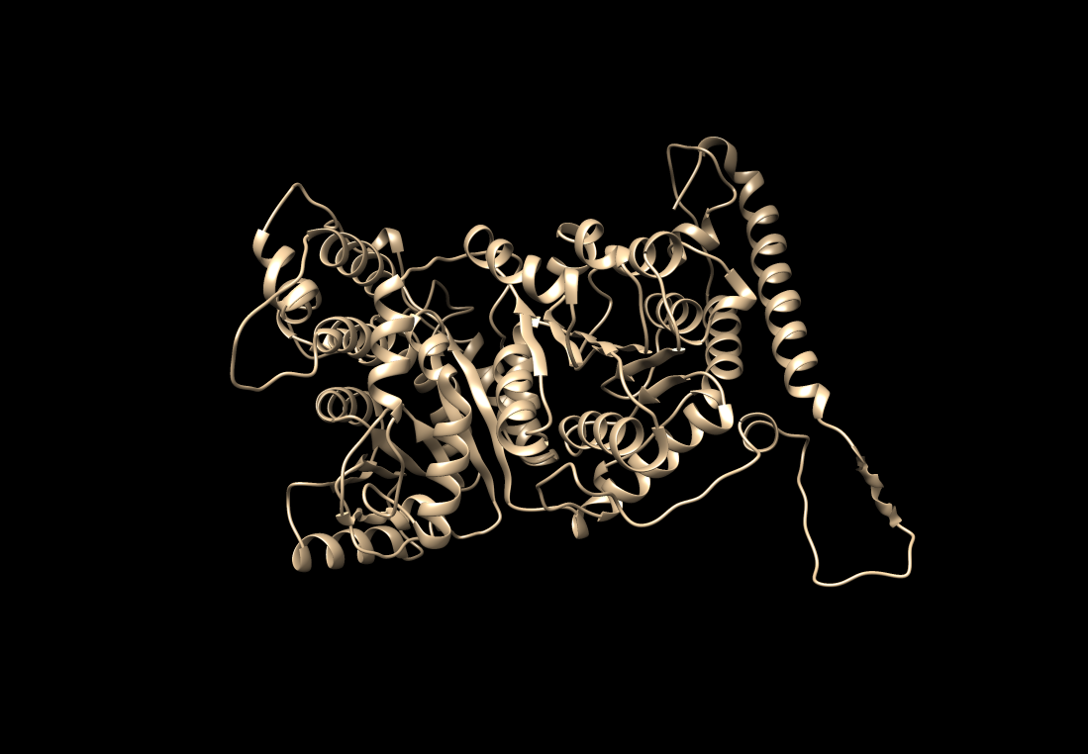
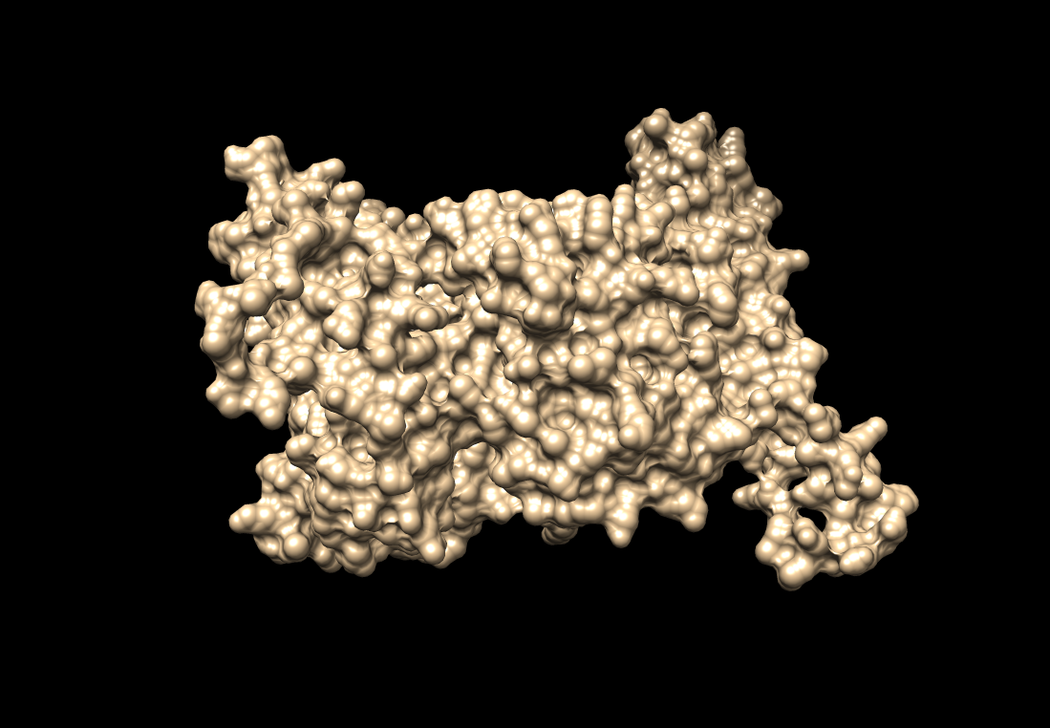

Slide 17
The hard sphere model
The simplest space-filling representation of a molecule is the hard-sphere model.
Each atomic sphere is given the van der Waals radius of the atom.

Slide 18
The hard sphere model
Recommended values for the radii based on atom type:
Recommended values for the distance between the centers of each pair of spheres
The spheres are allowed to interpenetrate
C | H | N | O | P | S
1.52 | 0.70 | 1.36 | 1.28 | 2.18 | 2.10

Slide 19
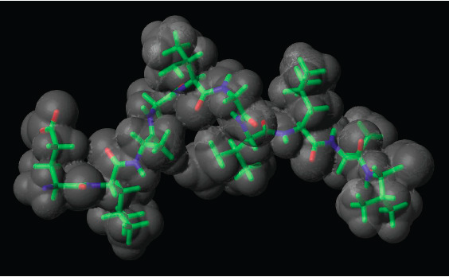
The hard sphere model → The van der Waals Surface
The van der Waals surface of the molecule is made up of the parts of the van der Waals surface of each atom that do not lie inside any other atom.

Slide 20
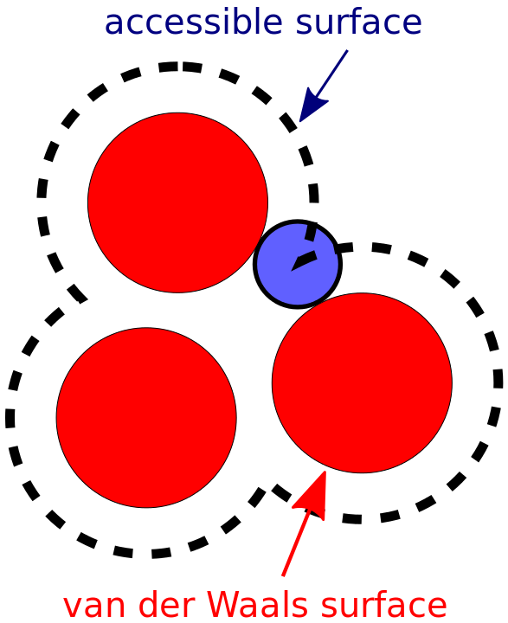
Solvent Accessibility
The surface of a macromolecule can be defined to be the part of the molecule that is accessible to solvent.
The outer surface of a protein molecule can be identified by rolling a water sized probe sphere over a molecule.

Slide 21
Connolly’s MS algorithm
A ‘water’ probe ball (1.4-1.8 Å radius) is rolled over the van der Waals surface.
Smooth the surface and bridges narrow ‘inaccessible’ crevices.

Slide 22
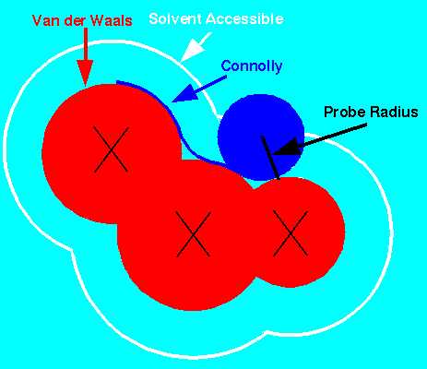
Surface Types

Slide 23
Types of Surface Patches
Convex face - the rolling sphere is in
contact with only 1 atom.
Saddle face - the rolling sphere is in
contact with 2 spheres.
Concave triangle - the rolling sphere
simultaneously touches 3 atom spheres.

Slide 24
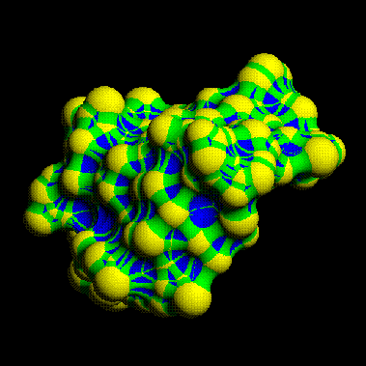
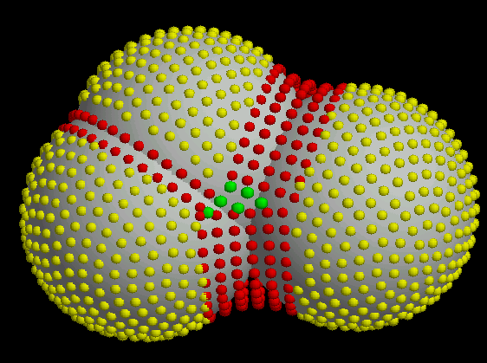
Example - the surface of crambin

Slide 25
Types of Surface Patches
# atoms touching the probe molecule | Degrees of freedom | Surface | Shape | Boundary
1 | 2 | Sphere | Convex | Circles of convex arcs
2 | 1 | Torus | Saddle | Convex and concave arcs
3 | 0 | Sphere | Concave | Three concave arcs

Slide 26
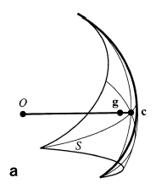
Basic Parameters
Atomic coordinates: c₁, c₂, …
Van der Waals radii: r₁, r₂, …
Probe radius: r_{p}
Each sphere is defined by a center and a radius

Slide 27
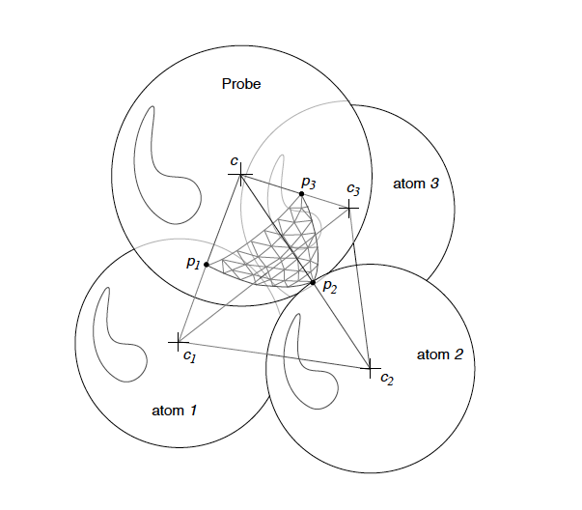
Rolling between 3 atoms

Slide 28
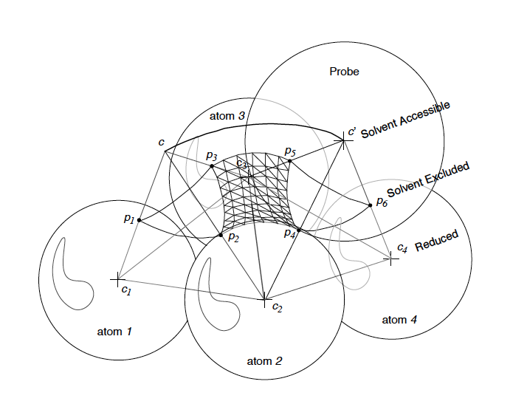
Rolling between 2 atoms

Slide 29
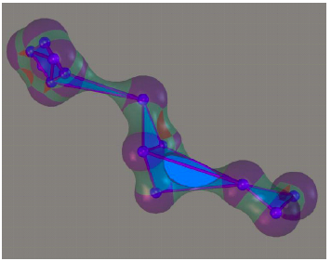
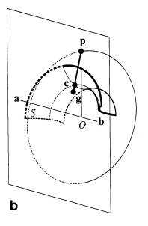
The torus

Slide 30
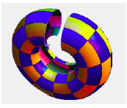
Torus calculation
Inter atomic distance: d = |b-a|
Torus axis unit vector: u = (b-a)/d
Torus center: halfway along the torus axis if the vectors are the same,
Otherwise …

Slide 31
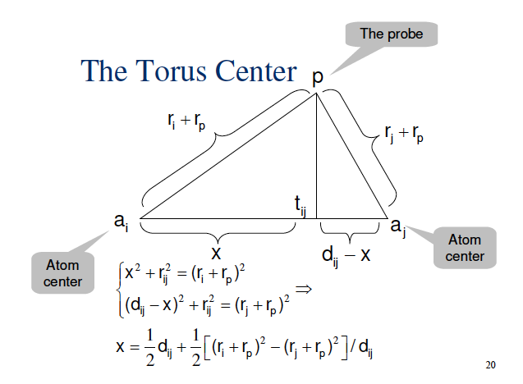

Slide 32
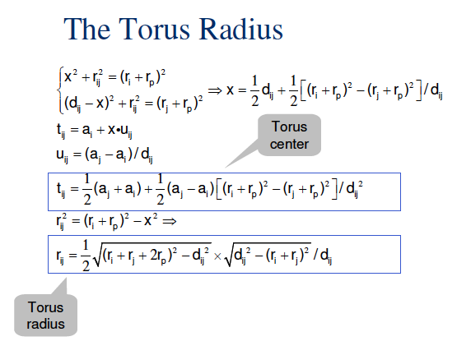

Slide 33
Rolling between 2 atoms

Slide 34
Rolling between 3 atoms

Slide 35
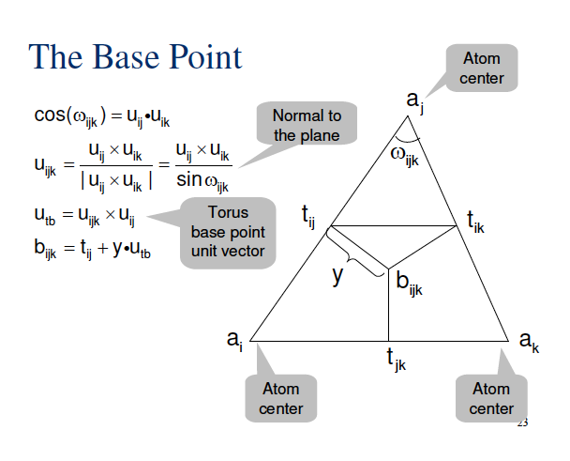

Slide 36
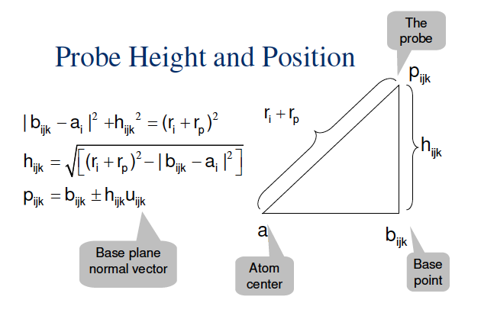

Slide 37
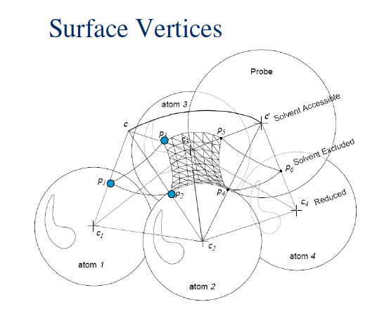

Slide 38
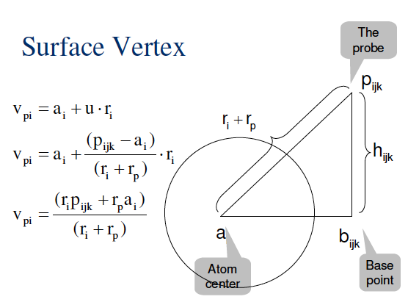

Slide 39
Surface Types

Slide 40
Shape Complementarity

Slide 41
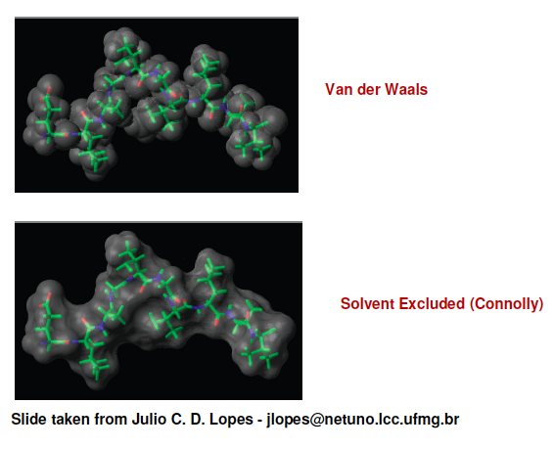

Slide 42
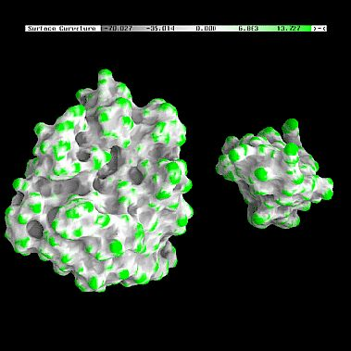
Example : Trypsin/Trypsin inhibitor
Figure from B. Honig’s Labs web-site at Columbia University.

Slide 43
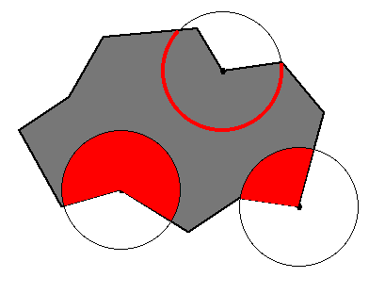
Curvature measured by Solid Angles
By measuring the fraction of the region of each sphere that lies inside the solvent excluded volume, one can quantitate surface region convexity and concavity
hole
knob

Slide 44
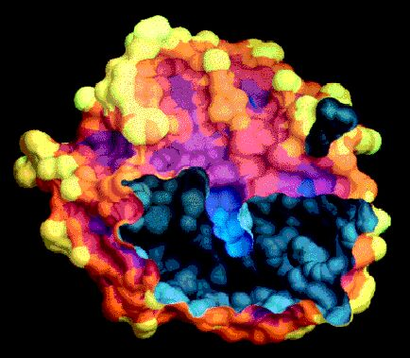
Chymotrypsin surface colored by solid angle (yellow-convex, blue-concave)

Slide 45
Surface complementarity calculation - discrete representations
Connolly points + normals - dense.
Lin et al. points - sparser.
Knobs - holes (Connolly; Norel-Nusinov-Wolfson) - sparse.
SPHGEN (Kuntz) - surface cavity modeling by pseudo-atom centers.

Slide 46
Critical points based on Connolly rep. (Lin, Wolfson, Nussinov)
Define a single point+normal for each patch.
Convex-caps, concave-pits, saddle - belt.

Slide 47
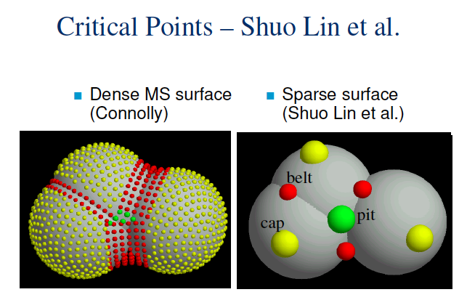

Slide 48
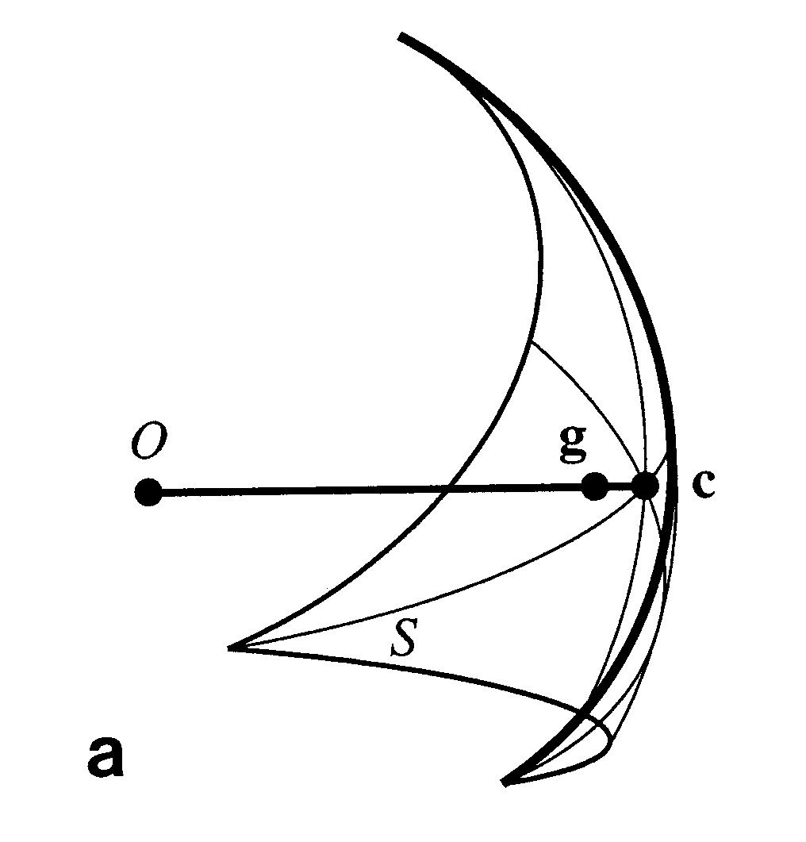
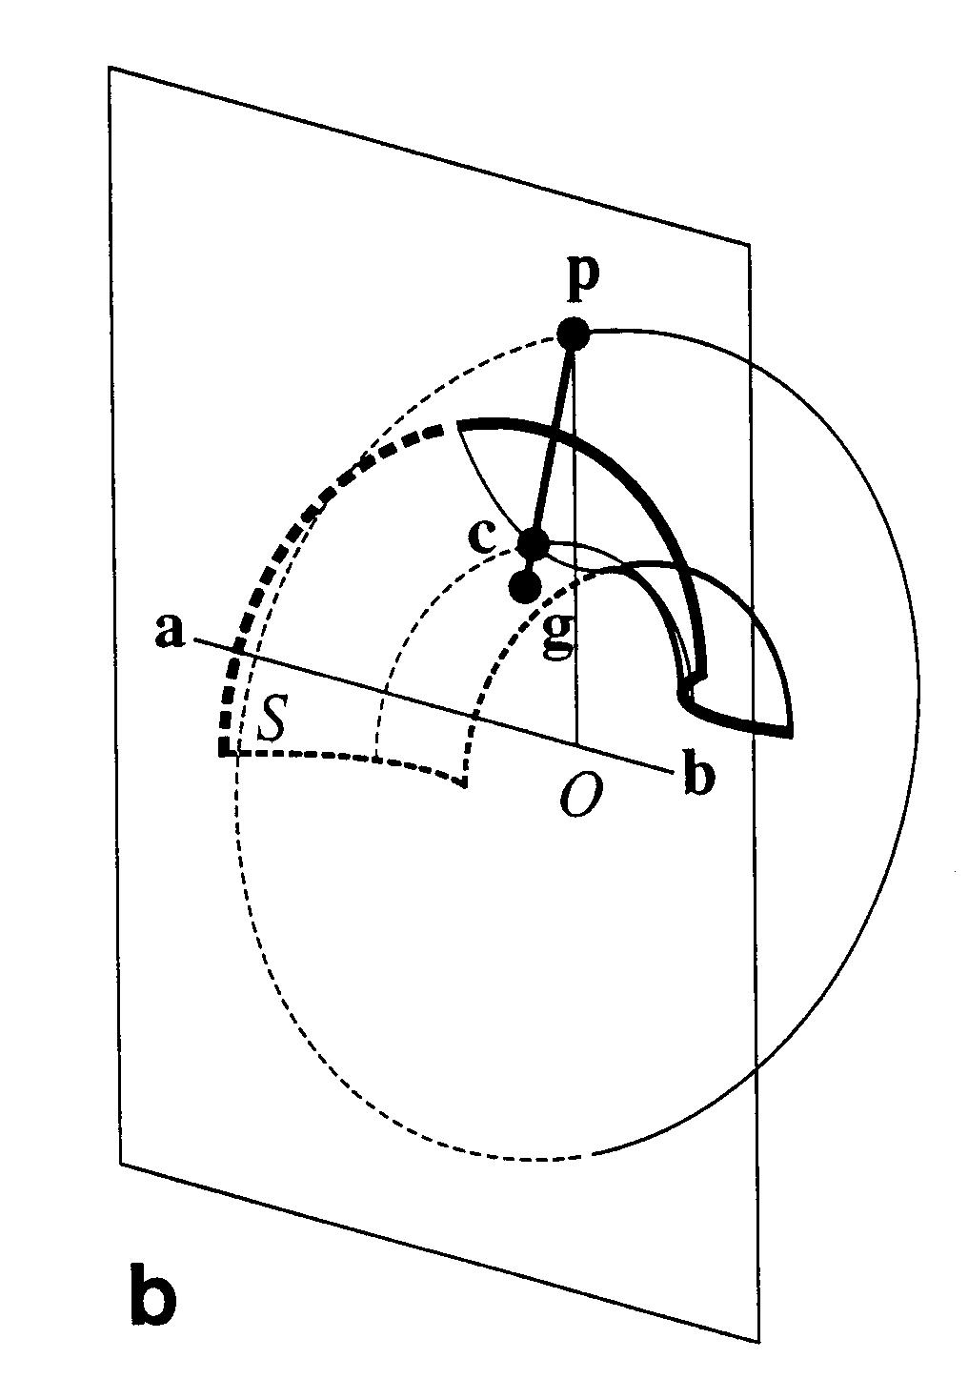
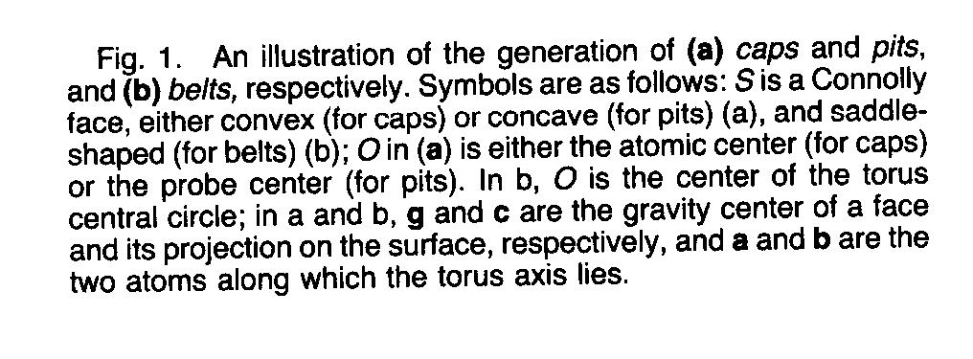
Critical point definition

Slide 49
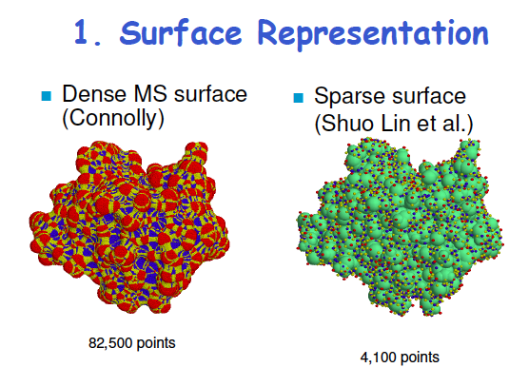

Slide 50
SPHGEN - complementary surface pseudo-atom calculation (Kuntz et al.)
Attempts to model packing of spheres in a cavity (of receptor).
The centers of the spheres model the positions of the ligand atomic centers.
Detects both cavities and hypothesized atomic center positions.

Slide 51
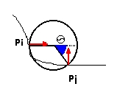
SPHGEN – detailed (1)
For each pair of Connolly points p_{i},p_{j} a sphere passing through this pair is placed such that its center is on the normal of one of the points.
For each point leave only the sphere with the smallest radius. (This discards all the spheres that penetrate the surface of the molecule.)
Leave only the spheres where θ< π/2 (to ensure concavity).

Slide 52
SPHGEN – detailed (2)
For each atom, leave only the sphere with the maximal radius. (This step leaves only the spheres that 'touch' the surface of the atom.)
If the points that define the sphere, p_{i} and p_{j}, belong to different atoms, and the distance between these atoms on the molecular sequence is less than 4 angst. - discard the sphere. (Not to capture helix grooves.)
The remaining spheres are called pseudo-atoms.

Slide 53
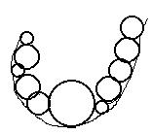
SPHGEN – detailed (3)
Cluster intersecting spheres to detect cavities.
(Optional) Split by removing largest spheres.

Slide 54
Curvature calculation (Zachmann et al.)
Fit 2’nd order patches to the Molecular Surface (possible at different resolutions).
Compute the mean and Gaussian curvatures from the II’nd fundamental form matrix.
Compute the principal curvatures of the quadratic patch.

Slide 55
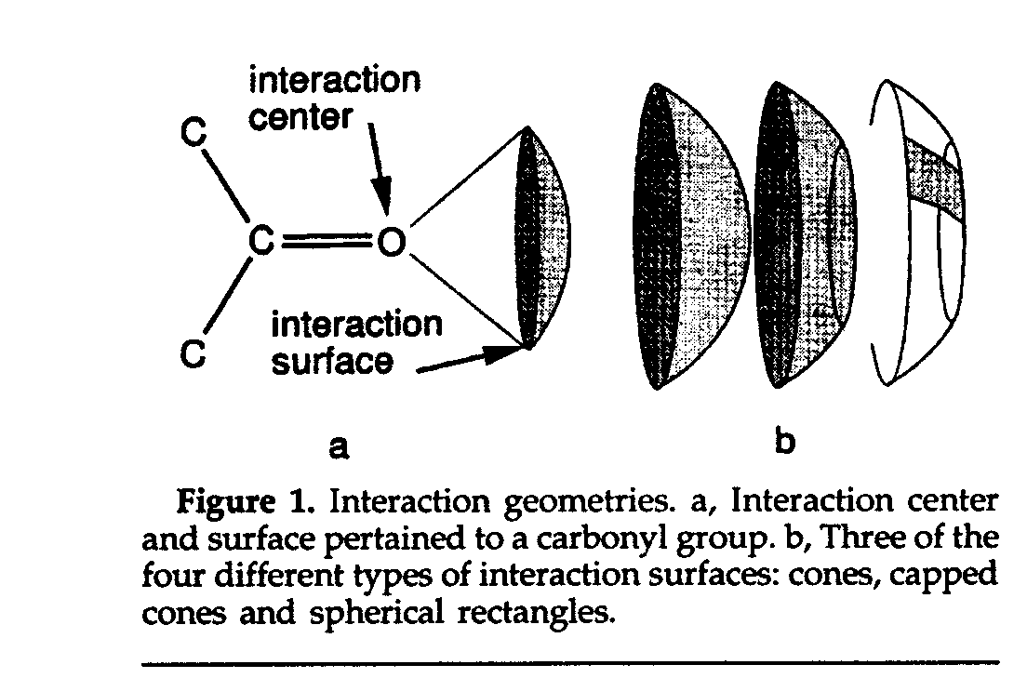
Hydrogen bond complementarity modelling (Lengauer et al.)

Slide 56
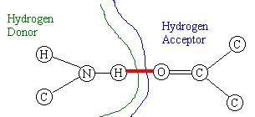
Hydrogen bond –reminder
Geometric constraints :
Distance.
Directionality.

Slide 57
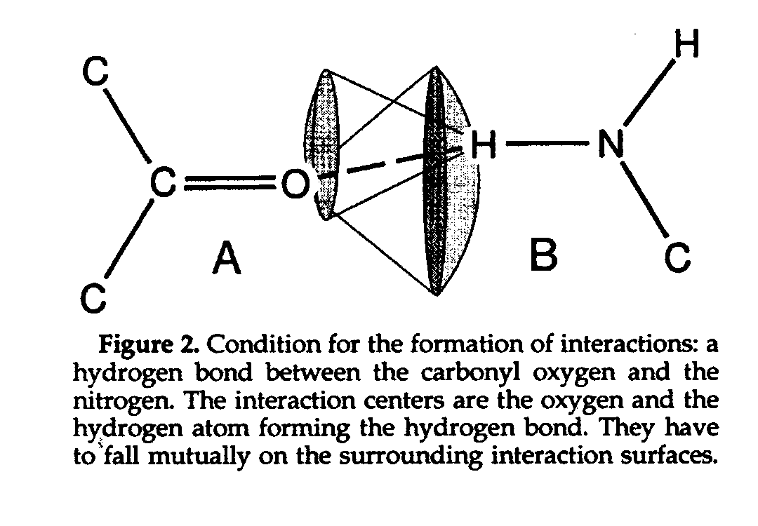
Hydrogen bond complementarity

Slide 58


Slide 59
Discrete Surface Representations
Connolly points + normals - dense
Lin et al. points - sparser
Knobs & holes – sparse
Physico-chemical patch centers
SPHGEN - pocket representation - sparse

Slide 60
Drawbacks
All surface and volume methods have a dependence on:
– atomic radii
– probe radius
– quality of atomic coordinates
The hydrogen atom positions are generally not known, and heavy atoms with hydrogens are approximated by a single sphere, whose van der Waals radius is augmented by one to three tenths of an angstrom.

Slide 61
Methods Overview
Dock
FFT
PatchDock

Slide 62

References:
Dock - first docking algorithm
protein – small ligand
I. Kuntz et al., A geometric approach to macromolecule-ligand interactions, J. Mol. Bio., 161, 269—288, (1982).
T.J.A. Ewing, S. Makino, A.G. Skillman, I.D. Kuntz, Dock 4.0: Search strategies for automated molecular docking of flexible molecule databases, J. Comp. Aided Mol. Design, 15, 411—428, (2001).

Slide 63
Dock - I. Kuntz (pioneering system) overview
Protein - ligand:
Compute Connolly’s MS of the receptor
Detect cavities by SPHGEN
Match SPHGEN pseudo-atom centers with ligand atom centers by detecting cliques in the “docking graph”
“Grid based” verification of candidate transformations
Calculate energy of binding

Slide 64

The DOCK Suite
Notes:
The original DOCK algorithm addresses rigid body docking using a geometric matching algorithm to superimpose the ligand onto a negative image of the binding pocket.

Slide 65
Representation: SPHGEN –pseudo-atom calculation in DOCK
Program SPHGEN identifies the active site, and other sites of interest
Each cavity is characterized by a set of overlapping spheres
For receptors, a negative image of the surface cavities is created
For a ligand, the program creates a positive image of the molecule
Notes:
Program sphgen identifies the active site, and other sites of interest.
Uses the points of the molecular surface and their associated normals to determine spheres to fill the site. It then reduces the number of spheres to one per atom and groups them into clusters.
You can inspect these clusters and regroup the spheres if necessary.
Whether or not crystallographic waters and ions should be preserved when generating surfaces for use by sphgen is a matter of some debate. In structures of complexes,water molecules and ions are often found in the protein binding pocket along with the ligand(s). How-ever, ligands can displace waters and ions, and the volume of a receptor site will be explored more com-pletely if the waters and ions are removed, so if you don’t have particular reasons for preserving any of the water molecules or ions in the crystal, it is probably best to remove all of them.

Slide 66




Example?

Slide 67


Descriptor Matching Methods: DOCK
Distance-compatibility graph in DOCK (Ewing and Kuntz 1997): distances between sphere centers and distances between ligand heavy atoms

Slide 68

Clique
A graph with 23 × 1-vertex cliques (the vertices)
42 × 2-vertex cliques (the edges)
19 × 3-vertex cliques (light and dark blue triangles)
2 × 4-vertex cliques (dark blue areas)
The 11 light blue triangles form maximal cliques
The two dark blue 4-cliques are both maximum and maximal
The clique number of the graph is 4

Slide 69
Docking graph & clique detection
The docking graph is motivated by the inner distance preservation in rigid bodies
Vertices - pairs of points (R_{i},L_{j}) belonging to the receptor and ligand respectively
An edge is defined between a pair of vertices iff the corresponding inner distances are ‘almost’ equal
A maximal clique in the graph = maximal matching subset between the receptor and the ligand points
Detection of all cliques of size < k is NP-complete (exp in k)
Usually Bron–Kerbosch algorithm is used

Slide 70
More on points matching
Can be directed by 2 additional features:
Chemical matching - labeling the site points such that only particular atom types are allowed to be matched to them.
Critical cluster - subsets of interest can be defined as critical clusters, so that at least one member of them will be part of any accepted ligand “match”.
Increase in efficiency and speed due to elimination of potentially less promising orientations!
Notes:
Chemical Matching
DOCK spheres are generated without regard to the chemical properties of the nearby receptor atoms.
Sphere “chemical matching” or “coloring” associates a chemical property to spheres and a sphere of
one “color” can only be matched with a ligand atom of complementary color.
Critical Points
The "critical point" filter requires that certain spheres be part of the set of sphere-atom pairs used to orient the ligand. Designating spheres as critical points forces the ligand to have at least one atom in that area of the enzyme, where that sphere is located. This filter may be useful, for example, when it is known that a ligand must occupy a particular area of an active site.

Slide 71
DOCK: summary
Define the target binding site points
Match the distances
Calculate the transformation for the orientation
Dock the molecule
Score the fit

Slide 72




Database search
Identify correct ligand orientation
Rank the binders among top scoring
Irwin et al. J. Med. Chem. 2009

Slide 73
Methods Overview
Dock - protein-ligand, geometry-based
today:
FFT - protein-protein, exhaustive search
PatchDock - protein-protein, geometry-based
FlexPepDock – protein-peptide docking

Slide 74
Protein-protein docking
Sampling strategy:
fast global search in 6D space based on shape complementarity. “soft” docking to handle steric clashes
Fast Fourier Transform (FFT) based methods
Geometric feature matching methods
refinement of docking models to reduce the number of clashes and improve model quality

Slide 75


Fast Fourier Transform (FFT) Grid representation
Katchalski-Katzir et. al, PNAS (1992)
Ephraim Katzir
Receptor
R
R
Ligand
L
+1
project proteins onto 3D grid
assign interior and surface voxel values
Notes:
FFT - based on a simple interaction-penetration based scoring function and a faster systematic search of all rigid body degrees of freedom.
The two molecules are projected onto a three dimensional grid of N x N x N points (here illustrated by a 2D grid), with separated surface and interior regions, each assigned with a different value. The surface layer is of size 1.5-2.5A so that penetrations smaller than these values are tolerated.

Slide 76
Fast Fourier Transform (FFT) Scoring function as correlation
translate one protein against the other
score = sum of products
R
R
R
R
R
R
L
L
L
Notes:
The sampling is done exhaustively for each possible translation of the ligand (=the smaller entity) relative to the receptor. The score is just a sum of multiplying the values of each overlapping cell pair - this way interactions between the two bodies interiors are penalized (-15*1) and surface interactions are rewarded (1*1). This is a way to accept minor clashes, but not severe penetrations. The scoring function considers shape complementarity only – the nature of the atoms is irrelevant here.

Slide 77



Fast Fourier Transform (FFT) Sampling strategy
Test all possible positions of ligand and receptor:
For each rotation of ligand (R)
evaluate all translations
(T) of ligand grid over
receptor grid
Correlation
Y Translation
X Translation
z
= correlation product: can be calculated by FFT
Notes:
A good geometric match is represented by a high positive peak, and low values reflect a poor match between the molecules. These calculations require N^3 multiplications just for scoring a given state. Therefore discrete Fourier Transform was used to calculate the score of each possible ste.
AXB = iFFT(FFT(A)*FFT(B))

Slide 78
Fast Fourier Transform (FFT) Algorithm Overview
R
R
Fast Fourier Transform
R
Discretize
A=DFT(a)
A*=[DFT(a)]*
Surface
Interior
Transformed
correlation function
C=A*B
1
<0 for R
>0 for L
L
Rotate
L
Discretize
L
Fast Fourier
Transform
B=DFT(b)
From http://zlab.bu.edu/~rong/be703/
Notes:
First, the receptor is discretized – transferred to the simple grid representation. Then for each possible ligand rotation, the ligand is discretized and for each ligand translation, instead of directly calculating the correlation function, discrete Fourier Transform is applied and allows a fast computation of the transformed correlation function, incorporating all ligand translations.

Slide 79
Fast Fourier Transform (FFT) Algorithm Overview (cont.)
R
Correlation
L
IFFT
S=iDFT(C)
Surface
Interior
Y Translation
X Translation
Binding Site
From http://zlab.bu.edu/~rong/be703/
Notes:
Next, the inverse Fourier transform is applied to get the desired correlation function. Positive correlation values are obtained when the contribution from surface contact outweighs that from penetration. The peaks relate to putative binding sites.

Slide 80

Algorithm

Slide 81
Parameters
Molecular surface thickness : 1.5-2.5 Å
Angular enumeration step D = 20 deg (2916 different orientations of molecule B)
r = - 15, d = 1
Grid step size h = 0.7-0.8 Å – optimal (1/2 of the C-C bond). For practical purposes start with the value of h = 1.0-1.2 Å and try the optimal parameter only for the large peaks obtained at low resolution.

Slide 82
FFT-based protein docking - summary
Exhaustive enumeration of the rotational and translational degrees of freedom
Since the scoring function is represented as a convolution, the enumeration of the translational degrees of freedom is made efficient exploiting FFT - O(N³ logN)
Allows introduction of electrostatics (or other scores) as the “complex number” component of the convolution
Time consuming, yet conceptually simple and appealing
Volumetric – does not use MS representation

Slide 83
FFT Methods & References
Katchalski-Katzir et al., Molecular surface recognition: Determination of geometric fit between protein and their ligands by correlation techniques, Proc. Nat. Acad. Sci. USA, 89, 2195—2199, (1992) MolFit
H. Gabb, R. Jackson & M. Sternberg, Modelling protein docking using shape complementarity, electrostatics and biochemical information, J. Mol. Bio, 272, 106—120, (1997) 3D-Garden
Ritchie DW, Kemp GJ. Protein docking using spherical polar Fourier correlations. Proteins, 39(2):178-94 (2000) HEX
Chen R, Weng Z. Docking unbound proteins using shape complementarity, desolvation, and electrostatics. Proteins 47(3):281-94 (2002) ZDOCK
Comeau SR, Gatchell DW, Vajda S, Camacho CJ. ClusPro: an automated docking and discrimination method for the prediction of protein complexes. Bioinformatics. 20(1):45-50 (2004).

